Slide 1

Comprehensive Study of Machine Learning, Deep Learning, and Ensemble Learning Approaches for Predicting Battery Health in Electric Vehicles
Presented by : Neeraj Singh Kathayat 23MCA1073 MCA:2023-2025
Under the Guidance of Dr A.Pravin Renold (Machine Learning)

Slide 2

Our goal is to develop a robust Machine Learning model for predicting electric vehicle battery health. This involves creating an intelligent system to accurately assess and forecast the battery's condition over time.
Enhancing Battery Management:Improve the efficiency of electric vehicle battery management systems.
Increasing Vehicle Reliability:Enhance the overall reliability of electric vehicles by ensuring the health of their power source.
Cost Reduction:Minimize maintenance costs by proactively addressing potential battery issues.
Environmental Impact:Contribute to sustainable transportation by promoting the longevity of electric vehicle components.
Advancing Predictive Analytics:Push the boundaries of predictive analytics in the context of electric vehicle technology.
Supporting Smart Charging Infrastructure:Facilitate the development of smart charging stations by providing accurate battery health information.
OBJECTIVE AND SCOPE

Slide 3
Literature Review
Objective | Algorithm | Dataset | Result | Scope
[1] This paper focuses on reducing CO2 emissions through electric vehicles and emphasizes the importance of SOH prediction for battery safety and reliability. | used-Internal resistance analysis, LSTM networks for SOH prediction and Pearson correlation analysis for feature selection. | Custom Dataset. | RMSE values below 0.02. | The study recommends enhancing the model's applicability by training it with diverse operating condition data.
[2] Research extends its scope to address the challenges of assessing SOH for large-cycle Lithium-ion batteries, emphasizing the importance of safety management. | Dynamic Bayesian Network (DBN), Particle Filtering (PF) inference algorithm , SOH estimation,RUL prediction. | A. CC (constant-current) discharging process of LiFePO4/Graphite lithium-ion batteries (LIBs). B.A dynamic discharging process of LiFePO4/Graphite LIBs. | Accuracy for SOH Estimation: For Dataset A, RMSE 1.60%. For Dataset B, RMSE 1.60%. | scope-Focus on CC and CV charging profiles and neglecting the impact of operating temperature variations on battery health.
[3] The research addresses the critical challenge of accurately assessing the State of Health (SOH) of Lithium-ion batteries, crucial for safety managements. | Autoregressive Model, Equal Voltage Discharge Time (EVDT), Relevance Vector Machine (RVM) Algorithm, Error Correction Models. | Large-Cycle Lithium-ion Battery Dataset. NASA Data and CALCE Data | RMSEs consistently below 1%. | Need to further investigate and understand the performance of the AR-RVM model in comparison to the proposed AR-EVDTRVM model for small-cycle Lithium-ion battery SOH estimation.

Slide 4
Objective | Algorithm | Dataset | Result | Scope
[4] The critical issue of managing lithium-ion batteries in electric vehicles (EVs) by proposing a digital twin-based Battery Management System (BMS) | Extreme Gradient Boost (XGBoost) model and Extended Kalman Filter (EKF) for battery state estimation, monitoring, and prediction in the context of the Digital Twin framework. | NASA dataset | Improved State of Charge (SOC) and State of Health (SOH) estimation using Kalman Filter (KF) and XGBoost algorithms, demonstrating enhanced accuracy and performance compared to existing methods. | Enhance prediction accuracy, prioritize safety, and consider sustainability to support the widespread adoption of electric vehicles in a low-carbon future.
[5] ML model for accurately estimating the State of Health (SOH) of lithium iron phosphate (LFP)/graphite battery cells in real-world electric vehicle (EV) usage. | Objective-ML model for accurately estimating the State of Health (SOH) of lithium iron phosphate (LFP)/graphite battery cells in real-world electric vehicle (EV) usage. | Custom Dataset | Mean absolute percentage error (MAPE) of 0.28%, a root mean squared percent error (RMSPE) of 0.55% | Real-time data integration, collaboration with existing BMS, scalability, interpretability, uncertainty analysis, optimal management strategies, data standardization, extended battery life.
[6] To create a unified framework for precise lithium-ion battery SOH prediction, encompassing one-step, multi-step, and long-term forecasts, and addressing capacity recovery effects with uncertainty representation. | Empirical Mode Decomposition (EMD) ,Dynamic Single-Exponential Model,Particle Filter (PF) Algorithm | NASA dataset | The paper's proposed method achieves precise Lithium-ion battery State of Health (SOH) prediction across diverse scenarios, surpassing existing methods. | Involves refining uncertainty modeling, expanding real-world integration, adapting to energy storage systems, enabling edge computing deployment

Slide 5
Objective | Algorithm | Dataset | Result | Scope
[7] The paper explores Lithium-ion battery State of Health (SOH) prediction for electric vehicles, acknowledging the intricate capacity degradation mechanisms and the potential for deep learning to supplant conventional modeling and experimentation. | Convolutional Autoencoder (CAE), Bi-directional Long Short-Term Memory (LSTM). | NASA Ames dataset and the Oxford dataset. | Mean absolute error (MAE) 2% on the NASA dataset MAE of 0.038% on the Oxford dataset | Model optimization for practical implementation, edge/cloud integration, generalization, real-world validation.
[8] Accurately predicting the state-of-health of lithium-ion batteries using Variational Mode Decomposition (VMD) and Dung Beetle Optimization-Support Vector Regression (DBO-SVR) to enhance battery safety and reliability. | Support Vector Regression (SVR),Variational Mode Decomposition (VMD) for feature extraction and Dung Beetle Optimization (DBO) for parameter tuning. | NASA Dataset | accuracy with errors consistently within 1%. | Refining and validating the VMD-DBO-SVR model with diverse battery datasets, exploring real-time monitoring, and considering practical implementation.
[9] To enhance lithium-ion battery SOC prediction accuracy using an extreme learning machine algorithm based on the alternating factor multiplier method with improved regularization. | Extreme Learning Machine (ELM) for battery SOC prediction. | Custom dataset(lithium-ion battery (Sony VCT4 18650) as an experimental object.) | Contributes novel algorithms for lithium-ion battery SOC prediction, including algorithm comparisons, excitation function analysis, and real-world battery testing, with potential applications in battery management systems. | Involves refining and implementing the proposed algorithm in real-world new energy vehicle battery management systems for enhanced battery performance and longevity.

Slide 6
Objective | Algorithm | Dataset | Result | Scope
[10] To develop a CNN-based model for accurate State-of-Health (SOH) estimation of lithium-ion batteries using partial charge and discharge profiles, enhancing battery reliability in various applications. | Convolutional Neural Network (CNN) | The study uses aging data from four 3Ah Samsung 30T cells subjected to different fast-charging profiles for training and testing the SOH estimation model. | accuracy more than 80% SOH, with errors typically within ±2% and not exceeding ±3%. | Focus on developing more robust SOH estimation models that can accurately predict battery health below 80% SOH and accommodate varying charging methods.
[11] Accurate SOC Estimation for Electric Vehicle Batteries applications. | The AI method used in the research is the Random Forest Regression (RFR) algorithm, which is further optimized using the Differential Search Algorithm (DSA). | CALSE Dataset | RMSE 0.382% | Future work for this paper could include verifying the SOC estimation accuracy under aging cycle tests and implementing the proposed algorithm in real-time through hardware-in-the-loop testing.
[12] To create an online platform that predicts electric vehicle battery health during charging, enhancing charging operation and maintenance management. | Dynamic Time Warping (DTW) for feature extraction and the XGBoost algorithm for machine learning-based prediction of electric vehicle battery State of Health (SOH). | Custom dataset. | RMSE 0.674 and MAE 0.843 | Enhancing the platform's scalability and incorporating real-world testing and validation for broader adoption in electric vehicle charging infrastructure.

Slide 7
Objective | Algorithm | Dataset | Result | Scope
[13] To develop and validate models for predicting the State of Health (SoH) of Li-ion batteries, specifically focusing on multistep-ahead predictions and probabilistic forecasting. | Multiple Linear Regression (MLR) for SOH,Autoregressive Integrated Moving Average (ARIMA) models for battery health prognostics. | NASA PCoE Battery Dataset and CALCE Battery Dataset. | The paper's contribution is the development and validation of battery health prediction models, both deterministic and probabilistic, using actual battery datasets, with a focus on Li-ion batteries. | Refining RUL prediction, implementing a probabilistic framework for battery health, and enhancing model selection for different prediction lead times.
[14] To develop a data-driven prediction model, Auto-CNN-LSTM, for accurately estimating the Remaining Useful Life (RUL) of lithium-ion batteries. | Convolutional Neural Networks (CNN),Long Short-Term Memory (LSTM),Deep Neural Networks (DNN). | NASA Prognostics Center of Excellence (PcoE) | Accuracy approximately 95.16% | Further optimization of neural network parameters and applying the proposed Auto-CNN-LSTM model to other time series prediction problems in industrial settings.
[15] To develop a predictive model using Long Short-Term Memory (LSTM) neural networks to estimate the RUL of lithium-ion batteries. | Long Short-Term Memory (LSTM) neural network for predicting the RUL of lithium-ion batteries. Additionally, it employs polynomial fitting to establish a model for the state of health (SOH) of the batteries | Custom Dataset | 1% root mean square error (RMSE). | Focus on real-time integration, uncertainty estimation, and cost-benefit analysis to enhance the practicality and accuracy of lithium-ion battery health prediction for electric vehicles.

Slide 8
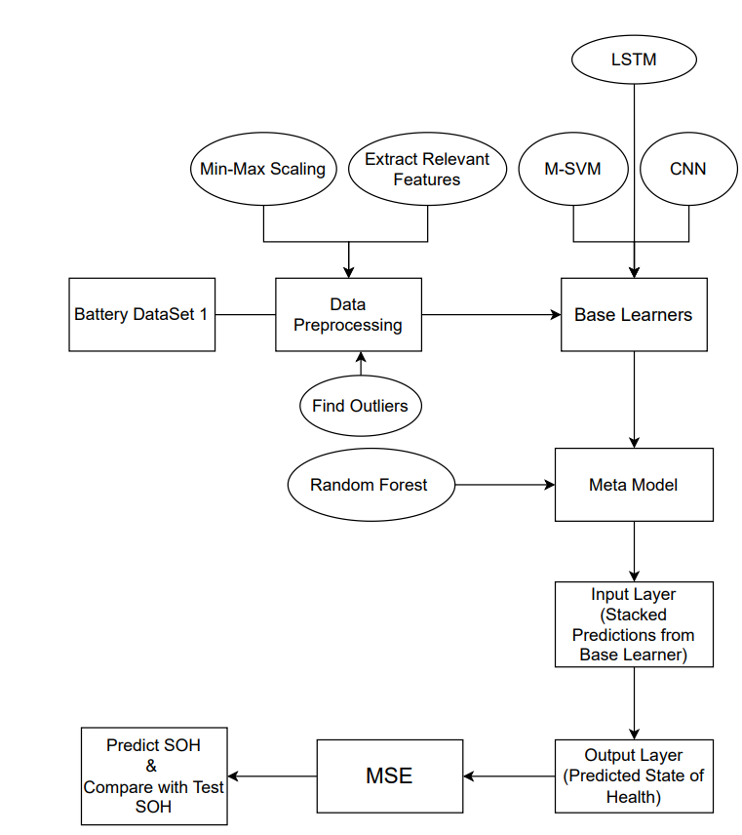
Architectural Design

Slide 9
1. Data Preprocessing: - Extract relevant features: cycle, ambient_temperature, capacity, voltage_measured, current_measured, temperature_measured, current_load, voltage_load, time. - Perform data cleaning: handle missing values and outliers. - Normalize or scale features for improved algorithm performance. 2. Algorithm Selection: - Modified Support Vector Machine (M-SVM): Superior SOH estimation. - CNN and LSTM Networks: Capture temporal dependencies in time-series data. - Ensemble Learning (Stacking): Combine predictions for improved accuracy and robustness. 3. Meta-Model (Stacking Ensemble): - Random Forest chosen for robustness, nonlinearity, ensemble learning, and interpretability. - Complements base models (M-SVM, CNN, LSTM) for comprehensive battery health prediction. 4. Feature Engineering: - Explore techniques for enhanced interpretability and predictive power. - Engineer features capturing degradation patterns, temperature effects, charging/discharging behavior. 5. Model Training and Evaluation: - Split dataset into training, validation, and test sets. - Train and fine-tune models (M-SVM, CNN, LSTM) using cross-validation. - Evaluate using metrics (MSE, RMSE, MAE, R2) on validation set. 6. Ensemble Model Construction: - Implement stacking ensemble to combine base model predictions. - Use Random Forest meta-learner for final ensemble prediction. - Fine-tune meta-learner to optimize ensemble performance. 7. Model Deployment and Interpretation: - Deploy ensemble model in Battery Management Systems (BMS) for continuous monitoring. - Provide interpretability through feature importance analysis for actionable insights.
METHODOLOGY

Slide 10
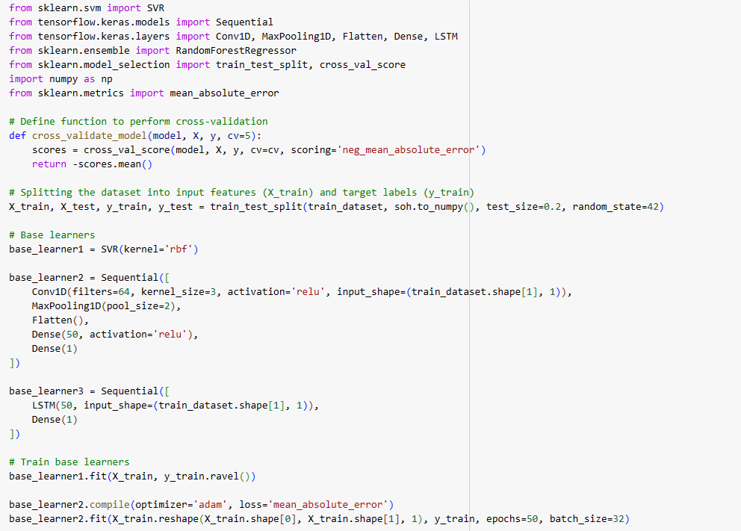
Implementation(Sample –code)

Slide 11
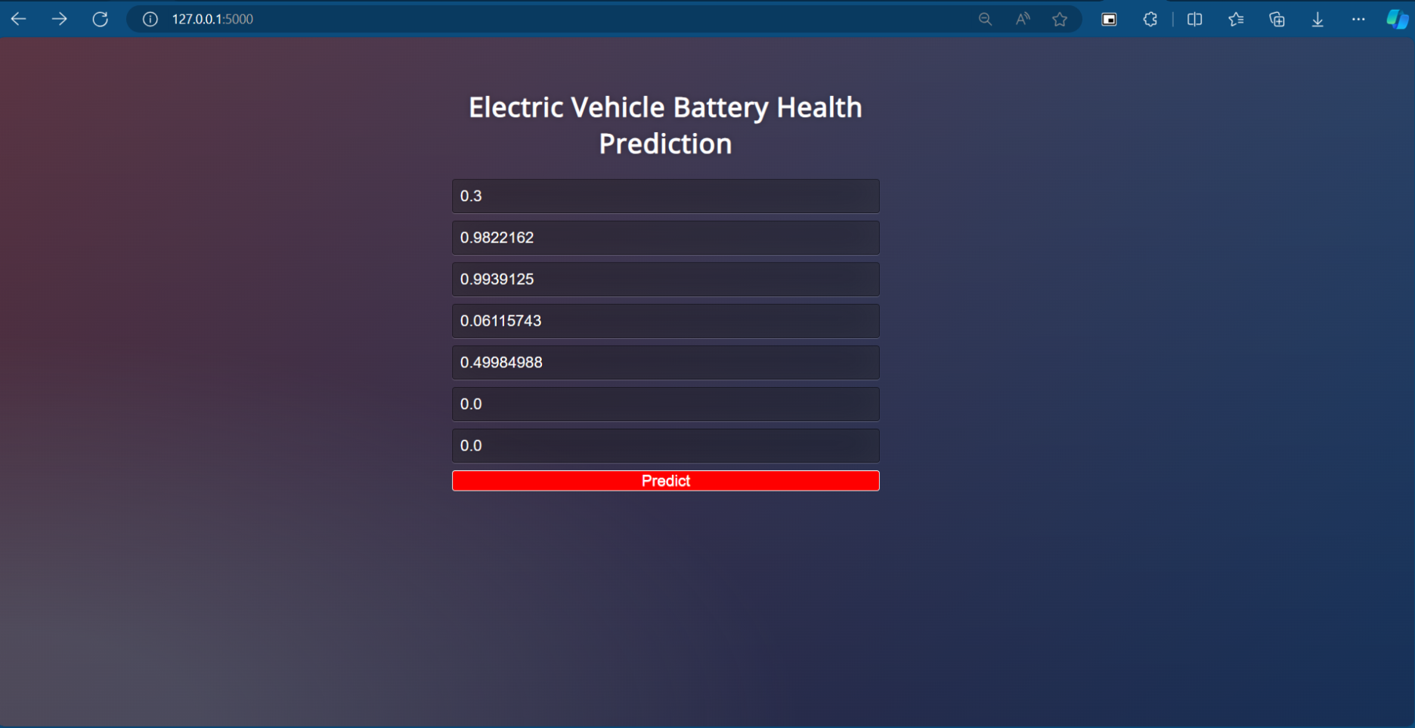


Slide 12
Result
Model | MSE | RMSE | MAE | R-squared
M-SVM | 0.0036 | 0.0605 | 0.0530 | 0.6209
CNN | 9.650865713977315e-07 | 0.00098 | 0.00064 | 0.99990
LSTM | 3.245014026062635e-06 | 0.00180 | 0.00160 | 0.99966
RFR | 1.410347088401453e-08 | 0.00011 | 2.9958087116145664e-05 | 0.9999

Slide 13
[1]. Yang, H., Hong, J., Liang, F., & Xu, X. (2023). Machine learning-based state of health prediction for battery systems in real-world electric vehicles. Journal of Energy Storage, 66, 107426.
[2]. Dong, G., Han, W., & Wang, Y. (2020). Dynamic Bayesian network-based lithium-ion battery health prognosis for electric vehicles. IEEE Transactions on Industrial Electronics, 68(11), 10949-10958.
[3]. Feng, H., & Yan, H. (2022). State of health estimation of large-cycle lithium-ion batteries based on error compensation of autoregressive model. Journal of Energy Storage, 52, 104869.
[4]. Jafari, S., & Byun, Y. C. (2022). Prediction of the Battery State Using the Digital Twin Framework Based on the Battery Management System. IEEE Access, 10, 124685-124696.
[5]. Zhao, J., Ling, H., Liu, J., Wang, J., Burke, A. F., & Lian, Y. (2023). Machine learning for predicting battery capacity for electric vehicles. ETransportation, 15,100214. [6]. Cai, L., Lin, J., & Liao, X. (2022). A data-driven method for state of health prediction of lithium-ion batteries in a unified framework. Journal of Energy Storage, 51, 104371.
[7]. Zhu, C., Gao, M., He, Z., Wu, H., Sun, C., Zhang, Z., & Bao, Z. (2023). State of health prediction for li-ion batteries with end-to-end deep learning. Journal of Energy Storage, 65, 107218. [8]. Wu, Chunling, Juncheng Fu, Xinrong Huang, Xianfeng Xu, and Jinhao Meng. "Lithium-Ion Battery Health State Prediction Based on VMD and DBO-SVR." Energies 16, no. 10 (2023): 3993.
REFERENCES

Slide 14
[9]. Zhang, Baozhong, and Guoqiang Ren. "Li-Ion Battery State of Charge Prediction for Electric Vehicles Based on Improved Regularized Extreme Learning Machine." World Electric Vehicle Journal 14, no. 8 (2023): 202.
[10]. Chen, Junran, Manjula Manivanan, Josimar Duque, Phillip Kollmeyer, Satyam Panchal, Oliver Gross, and Ali Emadi. "A Convolutional Neural Network for Estimation of Lithium-Ion Battery State-of-Health during. Constant Current Operation." In 2023 IEEE Transportation Electrification Conference & Expo (ITEC), pp. 1-6. IEEE, 2023.
[11]. Lipu, MS Hossain, M. A. Hannan, Aini Hussain, Shaheer Ansari, S. A. Rahman, Mohamad HM Saad, and K. M. Muttaqi. "Real-time state of charge estimation of lithium-ion batteries using optimized random forest regression algorithm." IEEE Transactions on Intelligent Vehicles 8, no. 1 (2022): 639-648.
[12]. Yan, Na, Yan-Bing Yao, Zeng-Dong Jia, Lei Liu, Cui-Ting Dai, Zhi-Gao Li, Zong-Hui Zhang, Wei Li, Lei Wang, and Peng-Fei Wang."Online battery health diagnosis for electric vehicles based on DTW-XGBoost." Energy Reports 8 (2022): 121-128.
[13]. De Falco, Pasquale, Luigi Pio Di Noia, and Renato Rizzo. "State of health prediction of lithium-ion batteries using accelerated degradation test data." IEEE Transactions on Industry Applications 57, no. 6 (2021): 6483-6493.
[14]. L. Ren, J. Dong, X. Wang, Z. Meng, L. Zhao and M. J. Deen, "A Data-Driven Auto-CNN-LSTM Prediction Model for Lithium-Ion Battery Remaining Useful Life," in IEEE Transactions on Industrial Informatics, vol.
17, no. 5, pp. 3478-3487, May 2021, doi: 10.1109/TII.2020.3008223.
[15]. Xu, Wenxia, and Congcong Yan. "Prediction of Lithium-ion Battery Remaining Useful Life Based on Long Short Term Memory." In 2022 IEEE nternational Conference on Advances in Electrical Engineering and
Computer Applications (AEECA), pp. 942-948. IEEE, 2022.

Slide 15
THANK YOU

